Slide 1
Unit 4: Symbol Table, Run-time Storage Administration, Error Detection and Recovery

Slide 2
Symbol Table
Symbol table is an important data structure used in a compiler in order to keep track of semantics of variables
It stores information about the scope and binding information about names, information about instances of various entities
It is built-in lexical and syntax analysis phases
The information is collected by the analysis phases of the compiler and is used by the synthesis phases of the compiler to generate code
It is used by the compiler to achieve compile-time efficiency

Slide 3
Used of symbol table in various phases of compiler
Lexical Analysis: Creates new table entries in the table, for example like entries about tokens.
Syntax Analysis: Adds information regarding attribute type, scope, dimension, line of reference, use, etc in the table.
Semantic Analysis: Uses available information in the table to check for semantics i.e. to verify that expressions and assignments are semantically correct(type checking) and update it accordingly.
Intermediate Code generation: Refers symbol table for knowing how much and what type of run-time is allocated and table helps in adding temporary variable information.
Code Optimization: Uses information present in the symbol table for machine-dependent optimization.
Target Code generation: Generates code by using address information of identifier present in the table.

Slide 4
Symbol Table Entries
Items stored in Symbol table:
Variable names
Constants
Procedure name
Function names
Literal constants and strings
Compiler generated temporaries
Labels in source languages
Information used by the compiler from Symbol table:
Data type and name
Declaring procedures
Offset in storage
If structure or record then, a pointer to structure table.
For parameters, whether parameter passing by value or by reference
Number and type of arguments passed to function
Base Address

Slide 5
Basic operations of Symbol table

Slide 6
Feature of Symbol Table
Insert
Delete
Lookup
Modify

Slide 7
Name Representation in Symbol Table
Fixed length Name Representation
Variable length Name Representation

Slide 8
Fixed length Name Representation
Space is fixed for the allocation of Name.
Wastage of space if length of name is too small.
Example:
Name |  |  |  |  |  |  |  |  |  | Attribute
S | U | M | M | A | T | I | O | N
S | U | M
N
N | 1

Slide 9
Variable length Name Representation
The amount of space required by string is used to store the names.
The name can be stored with the help of starting index and length of each name.
Example:
Name |  | Attribute
Starting Index | Length
0 | 10
10 | 4
14 | 2
16 | 3
0 | 1 | 2 | 3 | 4 | 5 | 6 | 7 | 8 | 9 | 10 | 11 | 12 | 13 | 14 | 15 | 16 | 17 | 18
S | U | M | M | A | T | I | O | N | $ | S | U | M | $ | N | $ | N | 1 | $

Slide 10
Data Structure used for Symbol Table
Requirements for symbol table:
For quick insertion of identifier and related information
For quick searching of identifier
Data structure of Symbol table
List data structure
Self Organizing List
Hash table

Slide 11
1. List data structure
Linear list is a simplest mechanism to implement symbol table.
Array is used to store names and associated information.
New name can be added in the symbol as they arrive.
A pointer “Available” is used to maintained at end of all records.
Advantage: takes minimum amount of space.
Name 1 | Info 1
Name 2 | Info 2
Name 3 | Info 3
. . . | . . .
Name n | Info n
Available
(start of empty slot)

Slide 12



2. Self Organizing List
Linked list is used.
A link field is added to each record.
We search the records in the order pointed by the link of link field.
A pointer “first” is maintained to point to first record of the symbol table.
Name 1 | Info 1
Name 2 | Info 2
Name 3 | Info 3
Name 4 | Info 4
start

Slide 13
3. Hash Tables
Hashing is important method to search the records in symbol table.
This method is superior to list organization.
Two tables is maintained:
1. Hash table
2. Symbol Table
Hash table consists of k entries from 0 to k. These entries are basically pointers to symbol table pointing to name of symbol table.
To determine whether the ‘Name’ is in symbol table, we use a hash function ‘h’
position=h(Name)

Slide 14
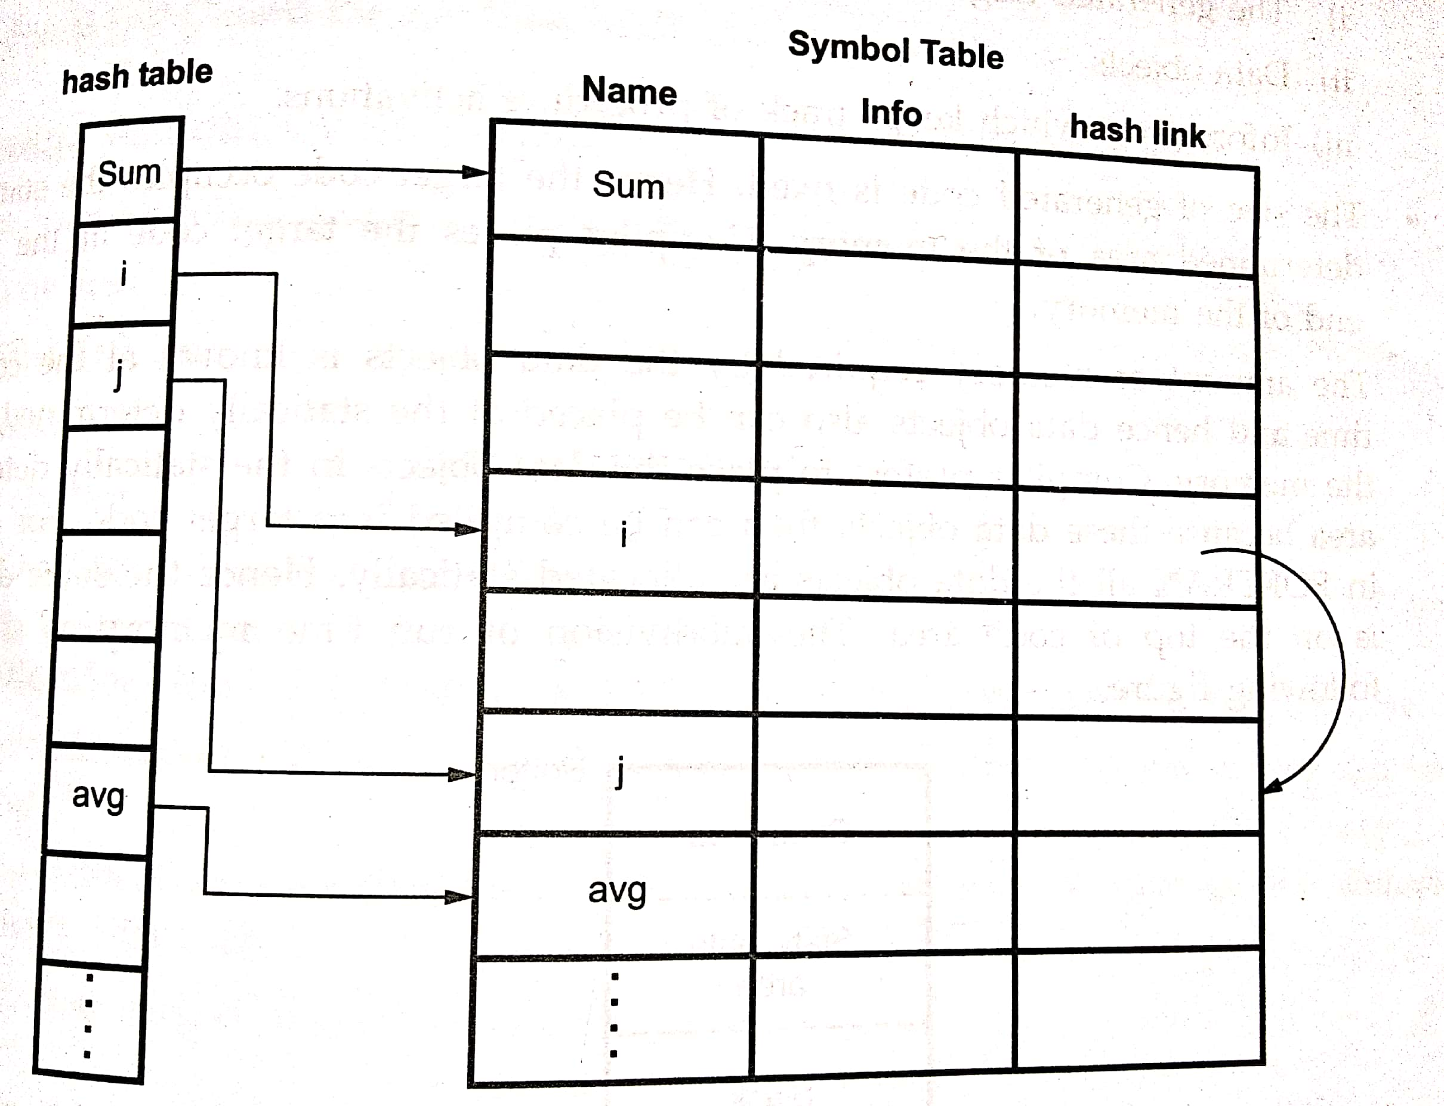

Slide 15
Advantage: Used for quick search
Disadvantage:
complicated to implement
extra space is required
obtaining scope of variables is very difficult.
collisions (open addressing, chaining, rehashing)

Slide 16
2. Run-time Storage Organization

Slide 17
Introduction
Compiler demands for block of memory to operating system.
Compiler utilizes the block of memory for running (executing) the compiled program.
This block of memory is called Run-Time Storage.

Slide 18
Division of Run-Time Storage to hold code and data
The generated target code (fixed size, static)
Data objects (static)
Information which keeps track of procedure activation (dynamic)

Slide 19
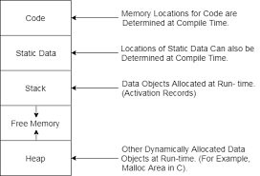

Slide 20
Storage Allocation Strategies
Static allocation
Stack Allocation
Heap Allocation

Slide 21
1. Static Allocation
Size of data objects is known at compile time.
Binding of object with allocated storage do not change. (Static Allocation)
In static allocation, the compiler can determine the amount of storage required by each data object. (Easy to find the address of data objects in activation record)

Slide 22
Limitations of Static Allocation
Static allocation can be done only if the size of data object is known at compile time.
The data structure cannot be created dynamically. (static allocation cannot manage the allocation of memory at run-time).
Recursive procedures are not supported by static allocation.

Slide 23
2. Stack Allocation
Storage is organized as STACK (LIFO).
This stack is called control stack.
As activation begins, the activation records are pushed into the stack and no completion of this activation, the corresponding activation records can be popped.
The locals are stored in each activation records. Hence locals are bound to corresponding activation record on each fresh activation.
The data structure cab be created dynamically for stack allocation.
Limitations:
The memory addressing can be done using pointer and index registers. Hence the stack allocation is slower than static allocation

Slide 24
3. Heap Allocation
If the values of non local variables must retained even after the activation record then such a retaining is not possible in stack allocation. For this limitation, we use heap allocation
Based on Linked list
Dynamic allocation
Heap allocation allocates the continuous block of memory when required for storage of activation records or other data objects (malloc).
Free function is used for deallocation.
Efficient allocation strategy:
Creates a linked list for free blocks and when any memory is deallocated that block of memory is appended in the linked list.
Allocates the most suitable block of memory from linked list (Use best fit technique for the allocation of block)

Slide 25
Activation Record
Manages the information needed by a single execution of a procedure.
An activation record is pushed into the stack when a procedure is called and it is popped when the control returns to the caller function

Slide 26
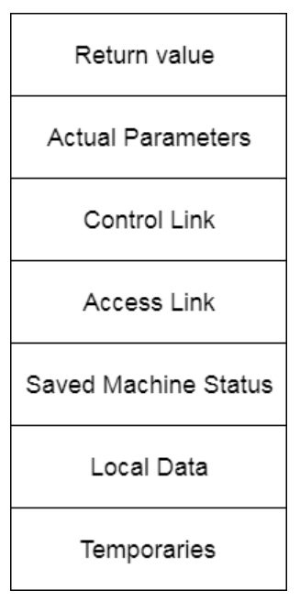
Various fields of Activation Record
Return Value: It is used by calling procedure to return a value to calling procedure.
Actual Parameter: It is used by calling procedures to supply parameters to the called procedures.
Control Link (Dynamic Link): It points to activation record of the caller. (optional)
Access Link (Static Link): It is used to refer to non-local data held in other activation records. (optional)
Saved Machine Status: It holds the information about status of machine before the procedure is called. (Machine register + Program counter)
Local Data: It holds the data that is local to the execution of the procedure.
Temporaries: It stores the value that arises in the evaluation of an expression.

Slide 27
Example: Formation of activation record
main()
{
int f;
f=factorial(3);
}
int factorial(int n)
{
if(n==1)
return 1;
else
return n*factorial(n-1);
}

Slide 28
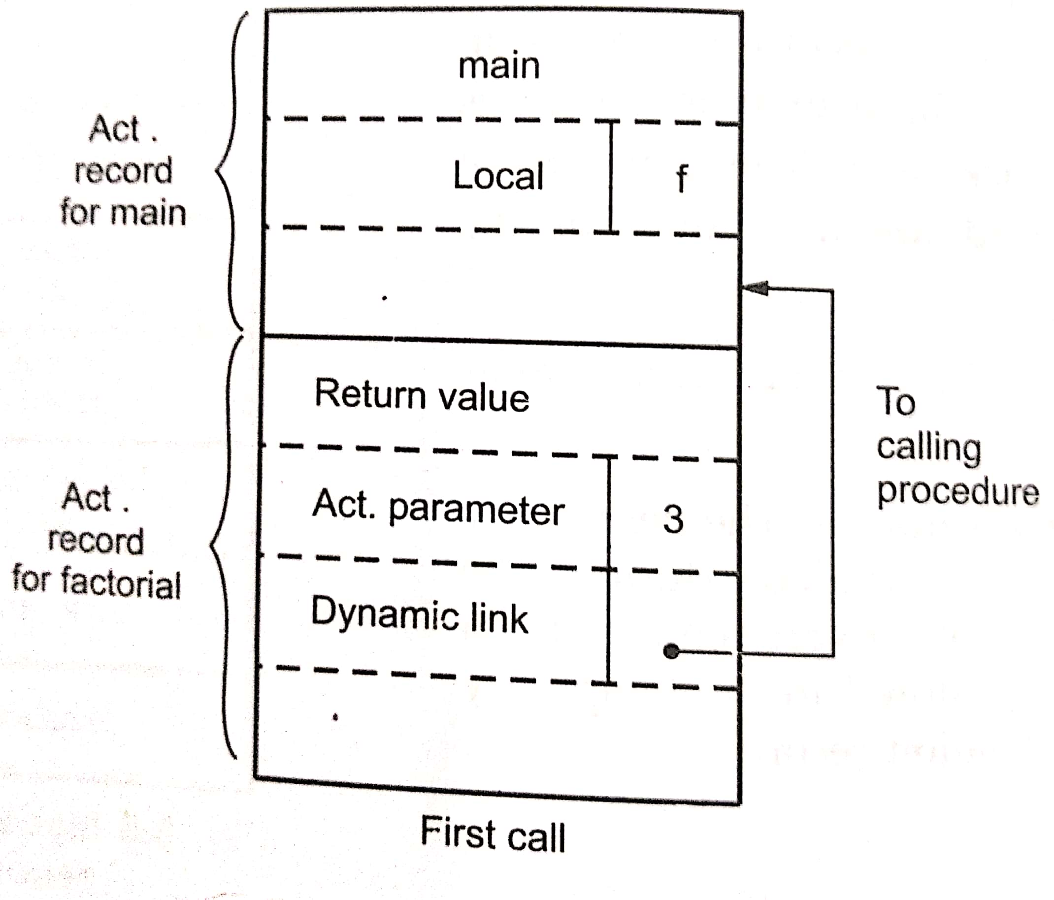
First call of factorial function

Slide 29
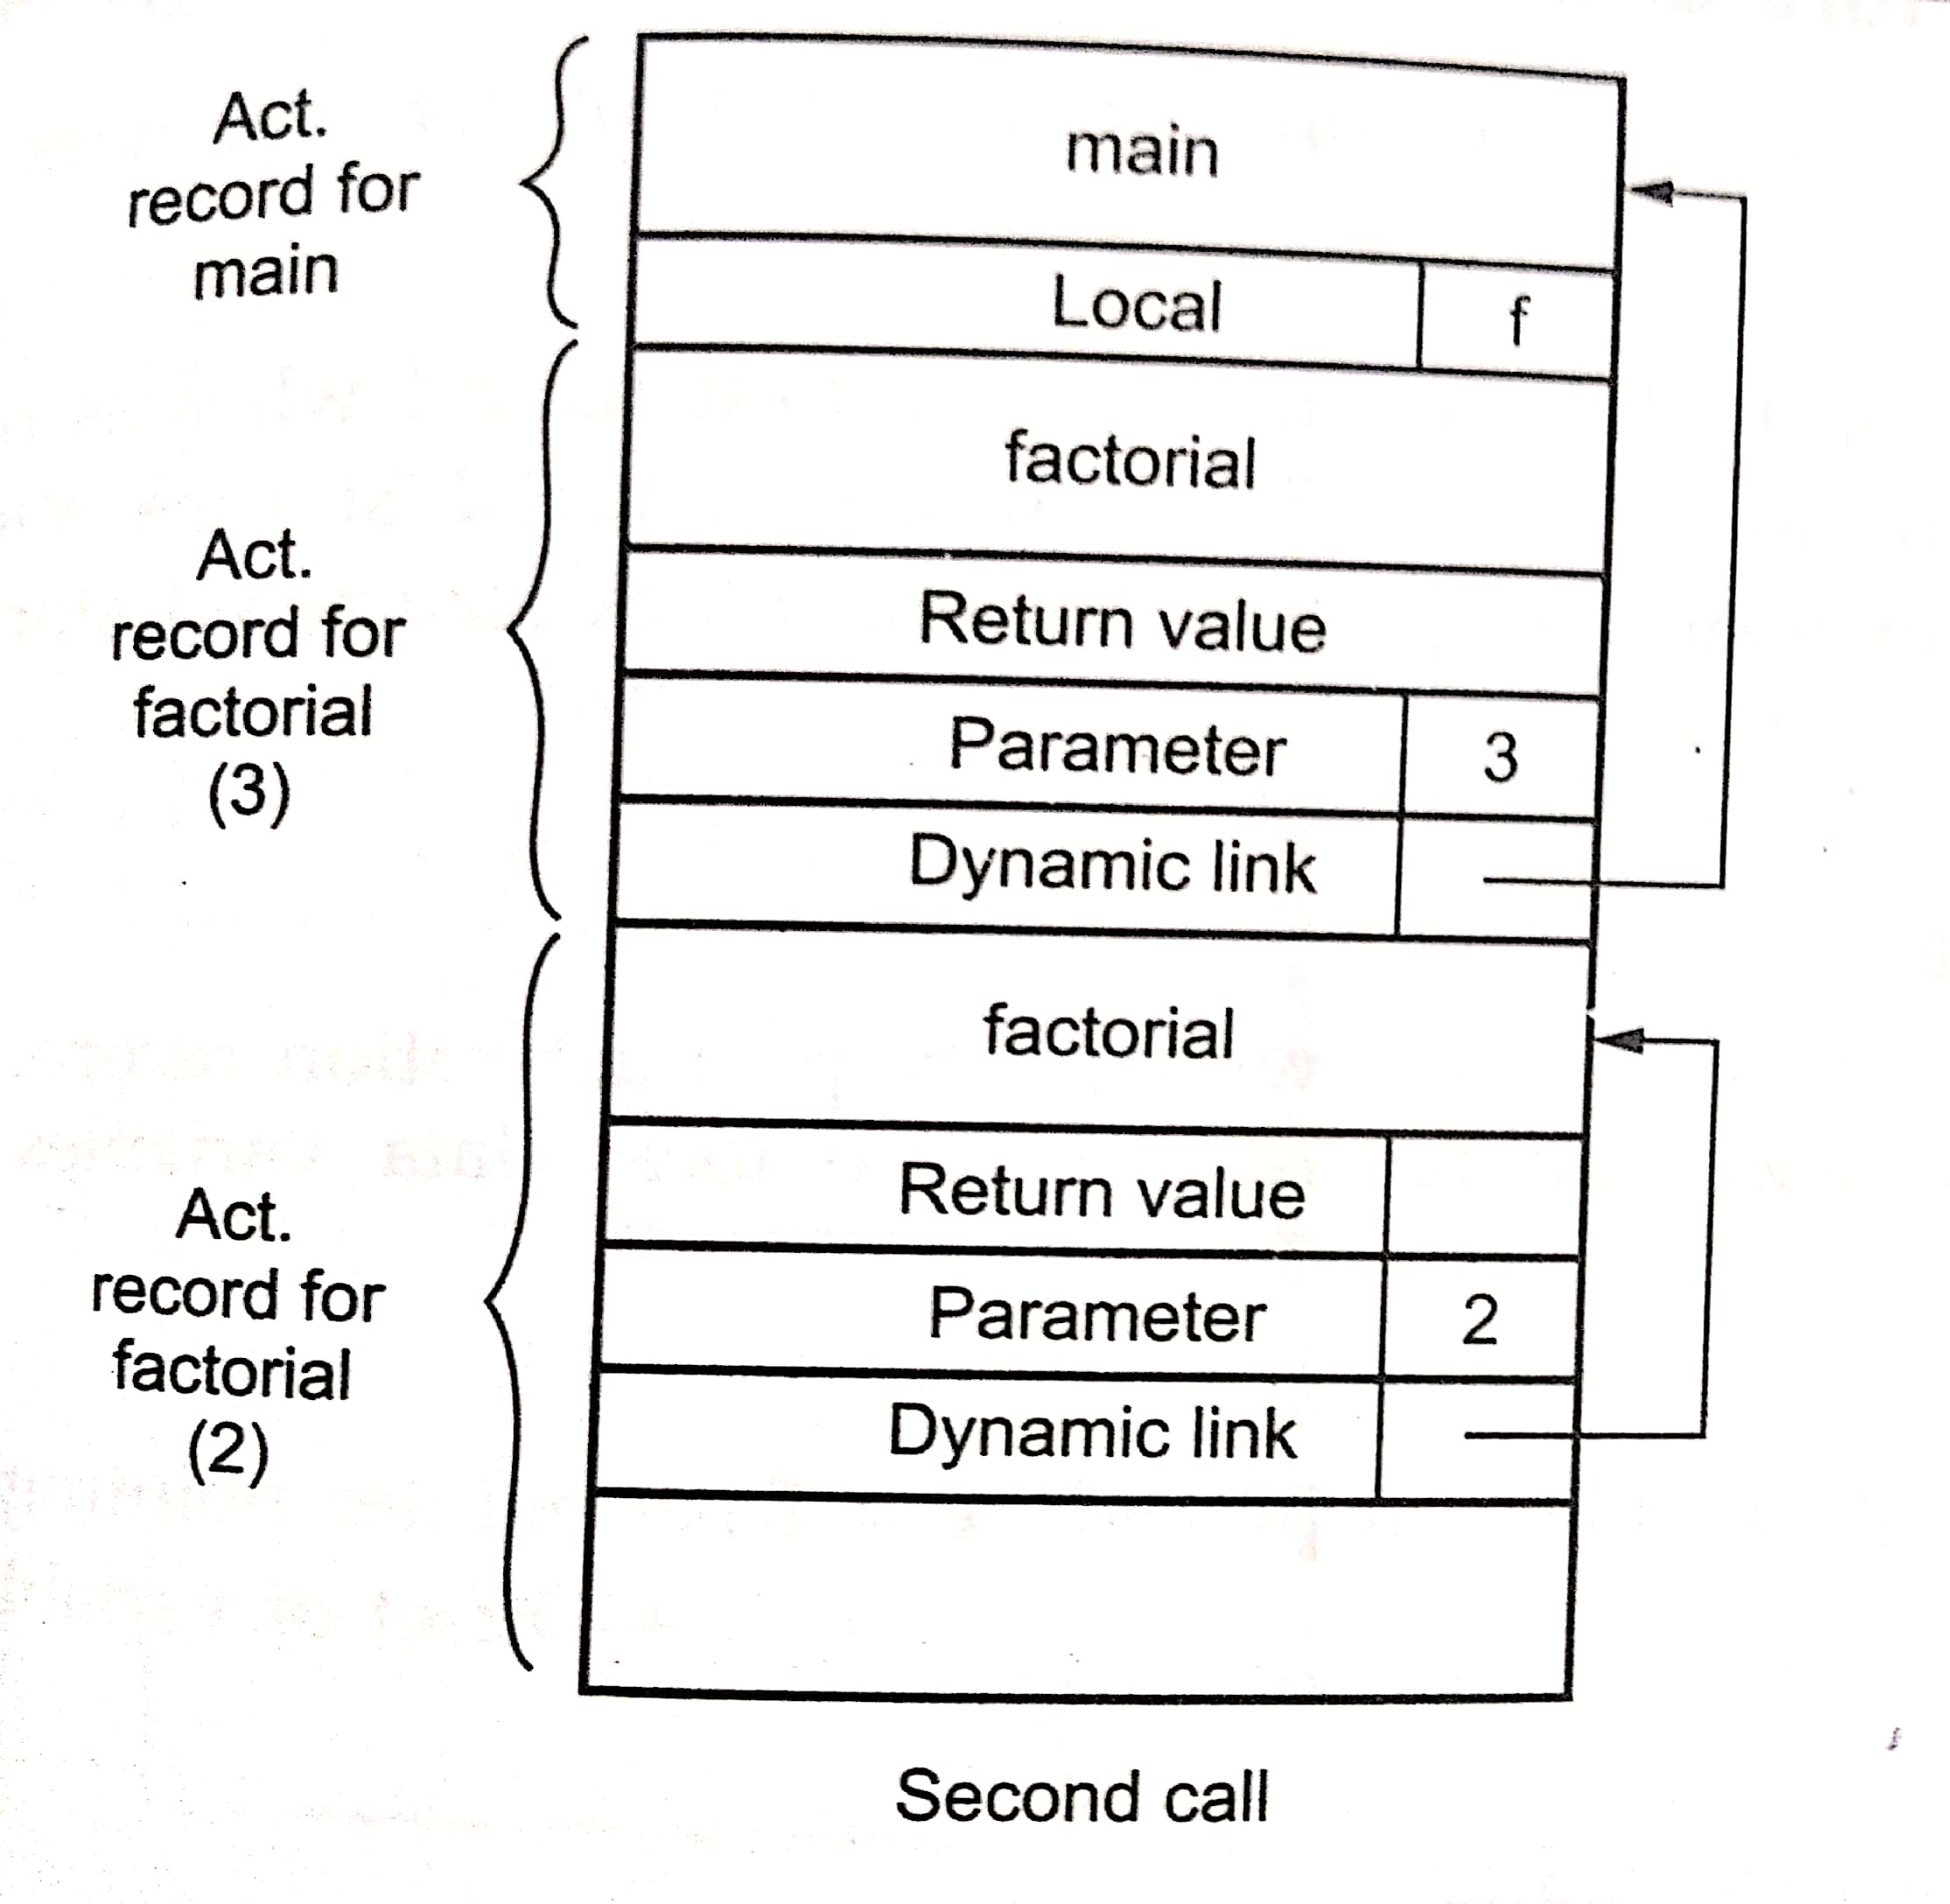
Second call of factorial function

Slide 30
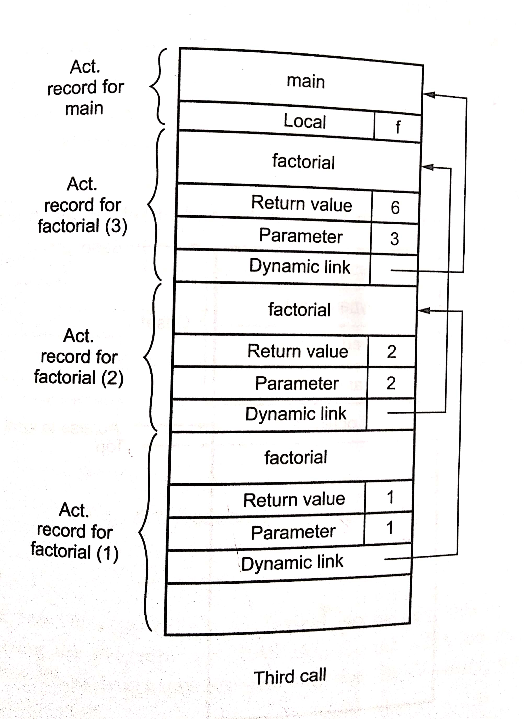
Third call of factorial function

Slide 31
Block Structure and Non-block Structure Storage Allocation
Local Data
Non-Local Data

Slide 32
Local Data
The local data can be accessed with the help of activation record.
Reference of any variable x in procedure
= Base pointer pointing to start of procedure
+ offset of variable x from base pointer

Slide 33
Example:
Procedure A
int a;
Procedure B
int b;
body of B
body of A

Slide 34
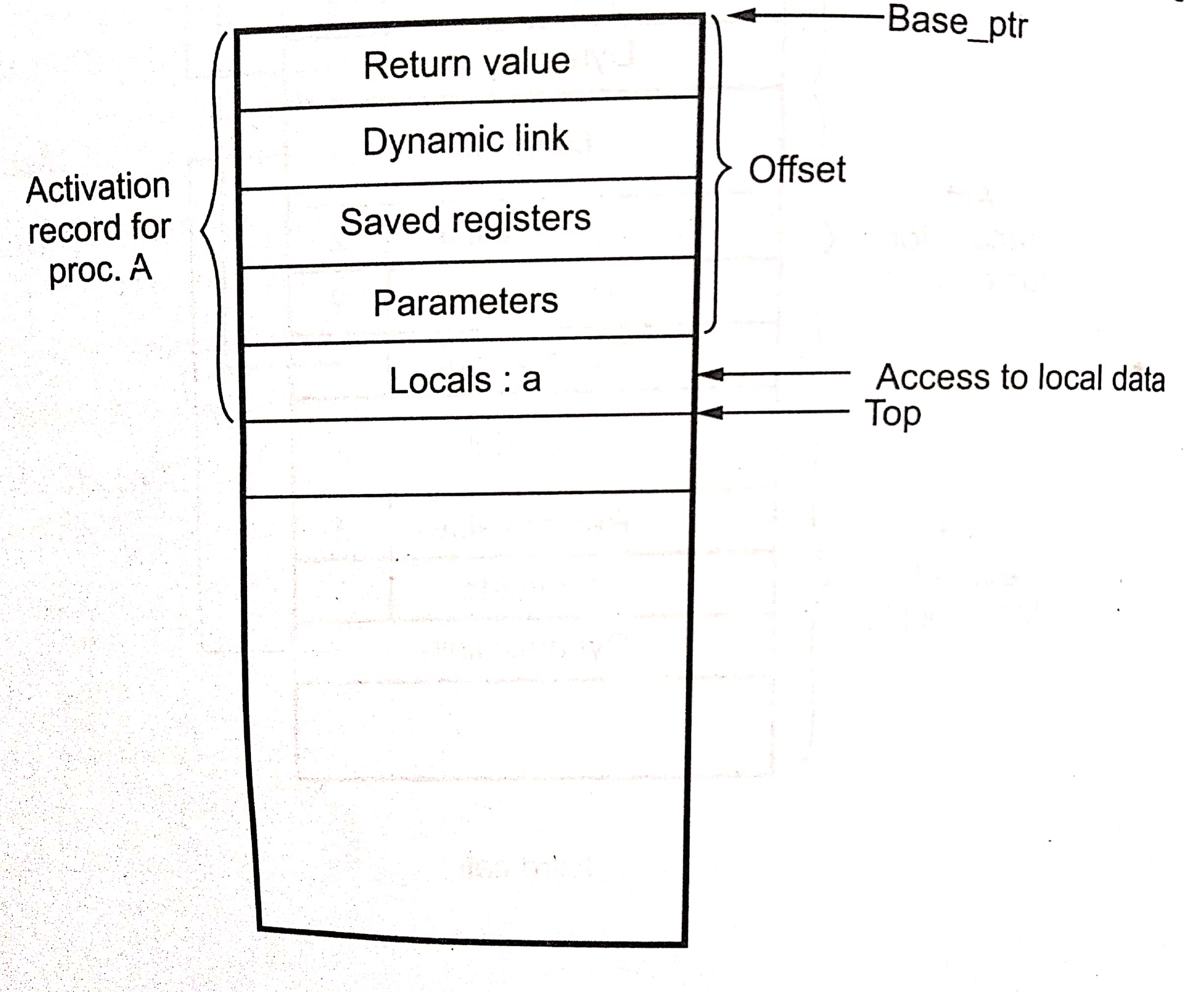
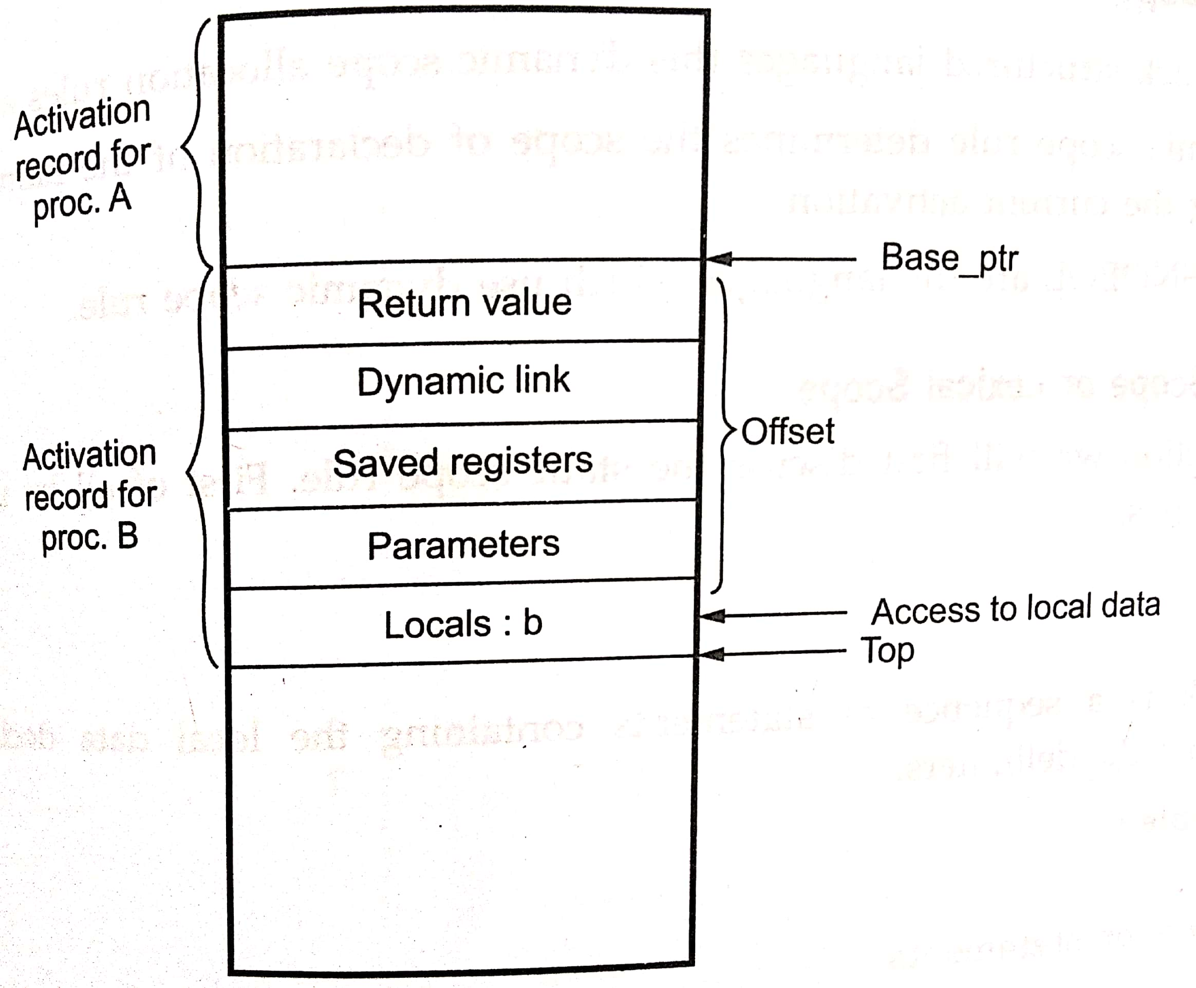

Slide 35
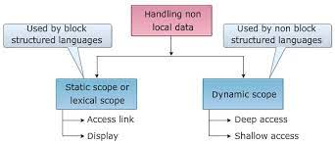
Access to Non-Local Names
For nonlocal names, there are two types of scope rule:
1. Static: (PASCAL, C, and ADA languages)
2. Dynamic: (LISP and SNOBOL languages)

Slide 36
Static Scope or Lexical Scope
Block structured language
Block: sequence of statements containing the local data representation and enclosed within the delimiters
Example:
{
Declaration statements
……..
}
The declarations are visible at a program point:
Declaration are made locally in the procedure
The names of all enclosing procedures
The declaration of names made immediately within such procedures

Slide 37
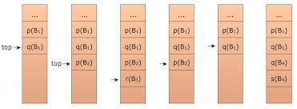
Example: Static scope of declarations for local variables
function()
{ //B1
int p,q;
{//B2
int p;
{//B3
int r;
}
}
{//B4
int q,s;
}
}

Slide 38
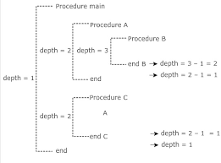
Lexical Scope for Nested Procedure
Nested Procedures
Nested Depth

Slide 39
Implementation of Lexical Scope
Access link:
The implementation of lexical scope can me obtained by using pointer to each activation record. These pointers are called access link.
2. Display:
It is expensive to traverse down access link every time when a particular nonlocal variable is accessed.
To speed up the access to non-locals can be achieved by maintaining an array of pointers called display.

Slide 40
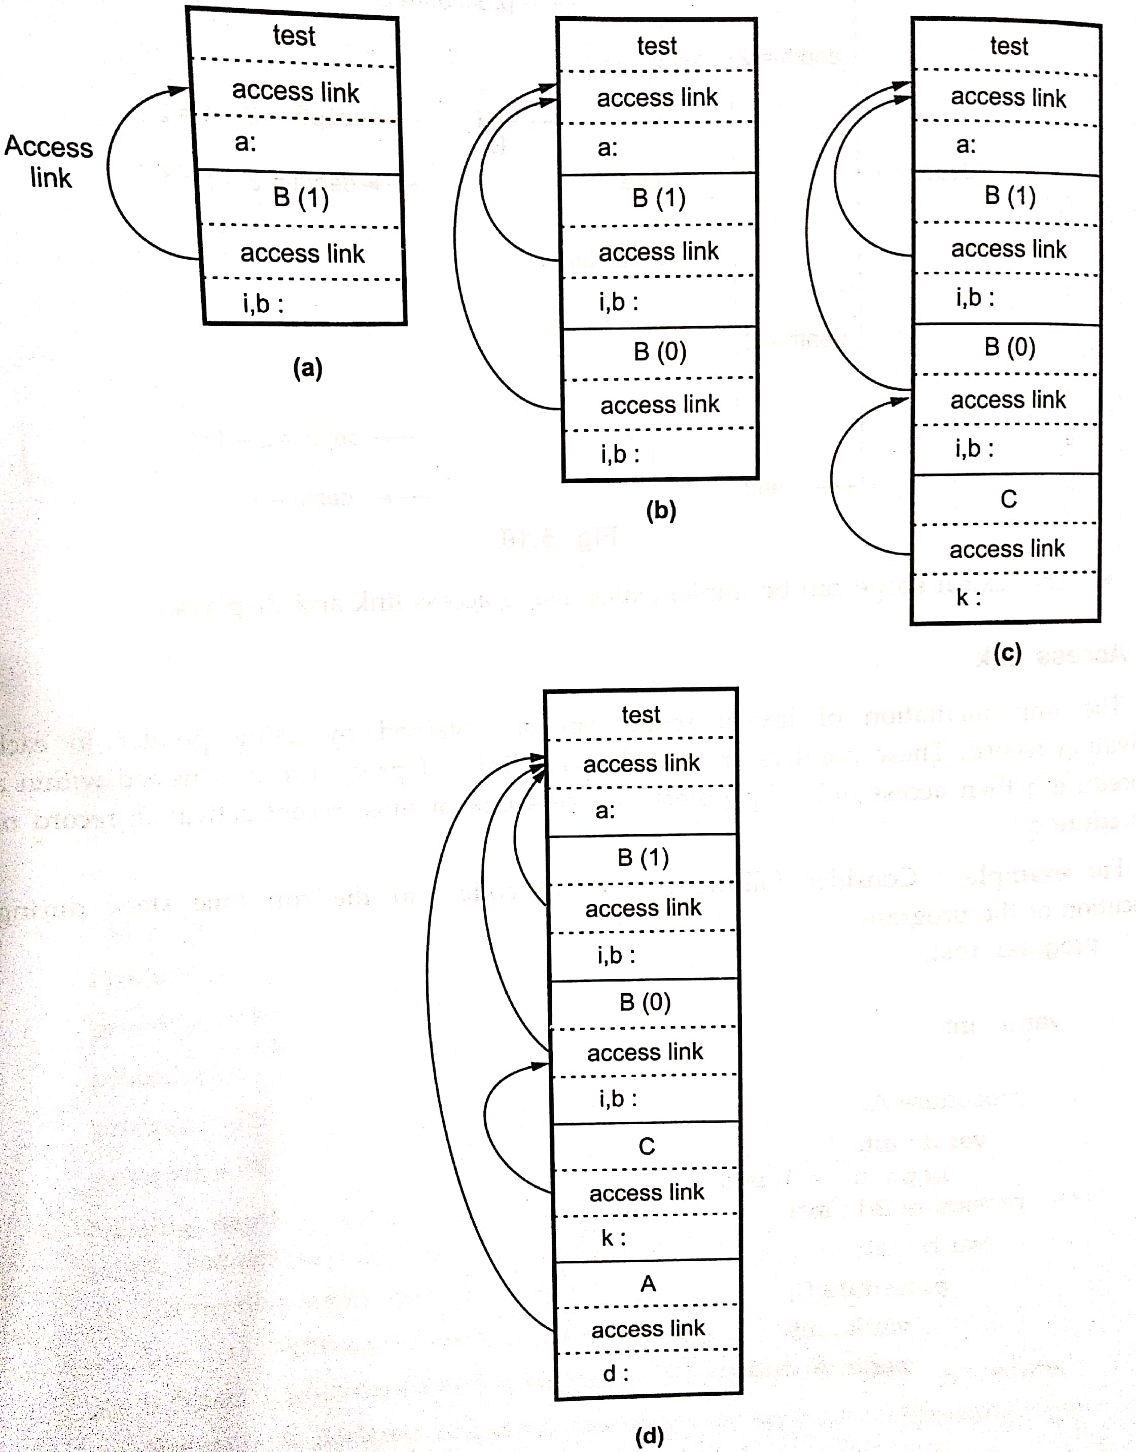
Example:
test() ///main()
{ int a; B(1); }
B(int i)
{ int b;
if (i != 0)
retrun B(i-1);
else
C();}
C()
{ int k; A();}
A()
{ int d; d=1;}

Slide 41
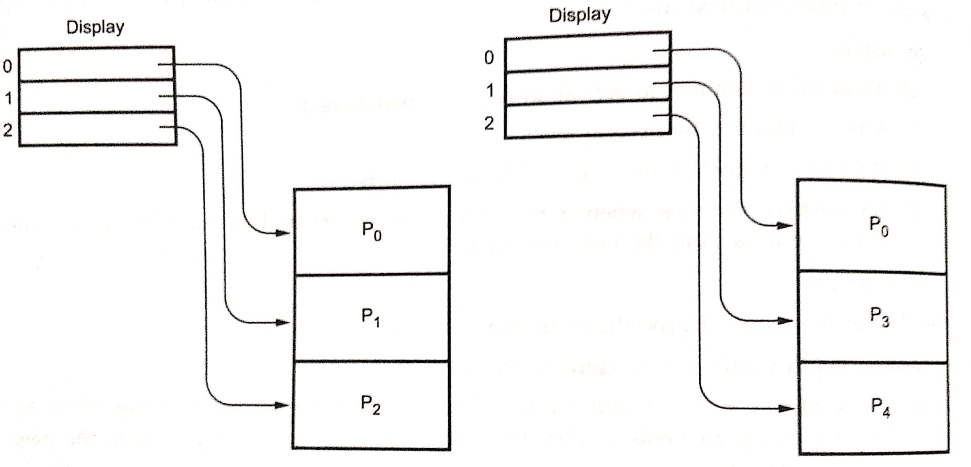
Display
p0()
{
p1()
{
p2()
{….}
}
p3()
{
p4()
{…..}
}
}

Slide 42
Error detection and Recovery in Compiler
In this phase of compilation, all possible errors made by the user are detected and reported to the user in form of error messages. This process of locating errors and reporting it to user is called Error Handling process.
Functions of Error handler
Detection
Reporting
Recovery

Slide 43
Classification of Errors

Slide 44
Lexical phase errors
errors detected during the lexical analysis phase.
Types of lexical errors:
Exceeding length of identifier or numeric constants (size of identifier and number)
Appearance of illegal characters ( printf(“Compiler Design”);$)
Unmatched string (eg. Missing beginning or end Comment)

Slide 45
Error recovery for Lexical Error
Panic Mode Recovery
In this method, successive characters from the input are removed one at a time until a designated set of synchronizing tokens is found.
Synchronizing tokens are delimiters such as ; or }
Advantage is that it is easy to implement and guarantees not to go to infinite loop
Disadvantage is that a considerable amount of input is skipped without checking it for additional errors

Slide 46
Syntactic Phase Errors
errors detected during syntax analysis phase
Types of syntax errors are
Errors in structure
Missing operator
Misspelled keywords
Unbalanced parenthesis

Slide 47
Example :
swicth(ch)
{
.......
.......
}
The keyword switch is incorrectly written as swicth. Hence, “Unidentified keyword/identifier” error occurs.

Slide 48
Error Recovery for Syntactic Phase Errors
Panic Mode Recovery
Statement Mode Recovery
Error Production
Global Correction

Slide 49
1. Panic Mode Recovery
In this method, successive characters from input are removed one at a time until a designated set of synchronizing tokens is found. Synchronizing tokens are deli-meters such as ; or }
Advantage:
easy to implement
guarantees not to go to infinite loop
Disadvantage:
considerable amount of input is skipped without checking it for additional errors

Slide 50
2. Statement Mode recovery
In this method, when a parser encounters an error, it performs necessary correction on remaining input so that the rest of input statement allow the parser to parse ahead.
The correction can be deletion of extra semicolons, replacing comma by semicolon or inserting missing semicolon.
While performing correction, most care should be taken for not going in infinite loop.
Disadvantage:
it finds difficult to handle situations where actual error occurred before point of detection.

Slide 51
3. Error production
If user has knowledge of common errors that can be encountered then, these errors can be incorporated by augmenting the grammar with error productions that generate erroneous constructs.
If this is used then, during parsing appropriate error messages can be generated and parsing can be continued.
Disadvantage:
difficult to maintain.

Slide 52
4. Global Correction
The parser examines the whole program and tries to find out the closest match for it which is error free.
The closest match program has less number of insertions, deletions and changes of tokens to recover from erroneous input.
Due to high time and space complexity, this method is not implemented practically.

Slide 53
Semantic errors
Errors detected during semantic analysis phase
Types of semantic errors:
Incompatible type of operands
Undeclared variables
Not matching of actual arguments with formal one

Slide 54
Example
int a[10], b;
.......
.......
a = b;
It generates a semantic error because of an incompatible type of a and b.

Slide 55
Error recovery for Sematic Error
if error “Undeclared Identifier” is encountered then, to recover from this a symbol table entry for corresponding identifier is made.
If data types of two operands are incompatible then, automatic type conversion is done by the compiler.

